Slide 1
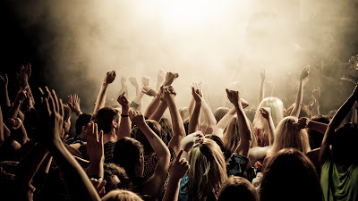
CoinFlip
I know you are going to like this show

Slide 2
What is CoinFlip
An Active Predictive Engine
That uses mobile technology to gather user preferences / tolerances
To generate with a high degree accuracy a prediction on weather user will like a live concert or DJ set

Slide 3
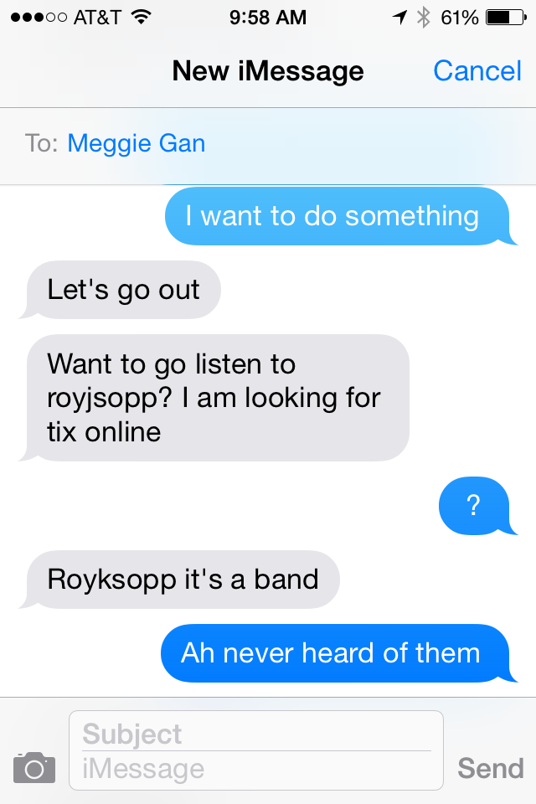
Problem
You have been invited to go a live concert or DJ event…
But you have no idea who the band or DJ is and do you know if you will you like
the show ? You can only tell so much from asking an arts web and or social
media pages

Slide 4

How does CoinFlip Solve the Problem
Locally Played Music + Cloud Music Likes + Media Profile + Price Point + Location Torrance
Active Predictive Algorithm
A prediction delivered to the user with a high degree of confidence if they are going to like a
live concert of DJ set or not

Slide 5
Users Personas
Male or Female in the 18-44 Demographic
Likes going to live shows
Has access to social media

Slide 6
Project Market Size
Target Demographic: Adults 18-44: 112,806,642
Percentage of Adults who have mobile phones: 91
Target Demographic with cell phones: 112,806,642 x .91 = 102,654,044
Parentage of Mobile Phone users with Applications: 43
Target Demographic with mobile phones and applications: 102,654,044 x .43 = 44,141,239
Percentage of population who attend live cultural events: 40
Market Size for CoinFlip: 44,141,239 x .40 = 17,656,495 users

Slide 7
Trends
Social Media
Access to large data sets
Interconnected technology
Mobile “ Hyper Connectively”

Slide 8
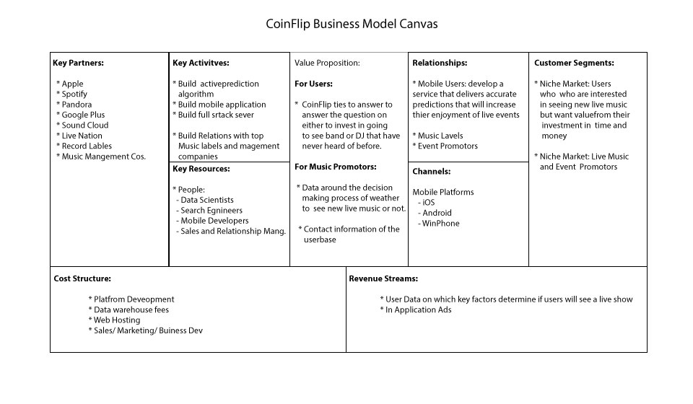
ConFlip: Business Model Canvas

Slide 9
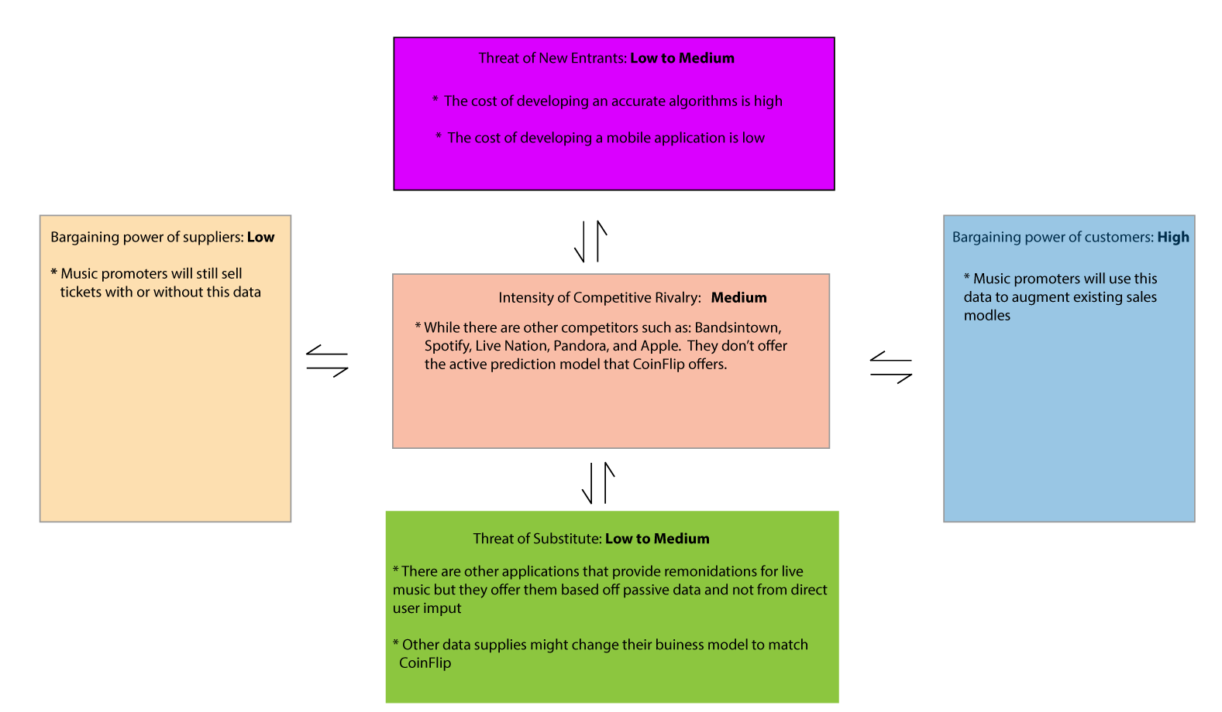

Slide 10
MVP
Hypotheses: People will use an application/service when they don't if they don't know
if they will like a live concert or DJ set or it.
MVP1: Set up a sms service that will allow a select users to ask the question
" will I like this show or not". If they get a "go the show, they will be directed to
fake product page”.
MVP2: Send out an email questionnaire to user base that will ask them to
detail what factors come into play when they decide to go a live show

Slide 11
Features
Recommendation Engine
1a. Develop the basic recommendation engine algorithm ( r.e.a) | Will provide the core feature of the application: to tell users if they are going to like a live concert or not | 1 | 1 | 1
1b. Integrate the user preferences into the r.e.a | The uses preferences will be added to r.e.a to personalize the experience and provide a more accurate results. | 2 | 2 | 1
Mobile Application
1.Applicatoin Framework
1a. Design and build basic applicaton frame workin the Xamerine platform | This allow the basic framework of the applicattion to be built in common launge (C#) and than compiled for either the ios and or android platoform. Allowing for maxium market coverage and saving on dev. Time and cost | 3 | 3 | 1
2.Login
1a. Allow the user to user social media login to again access into the application | This will allow for a quick and easy onboarding process to new and returning users. This will also allow access to the users social media api data | 4 | 4 | 3
3. Account Setup Wizard
3a. Set by the users preferences after login | This will combination of questions about location, price point, ect and logins to the users local media account. The inputs from this section will feed directly into the r.e.a., the more data the more accurate the results | 3 | 3 | 3

Slide 12
Features continued
4.User Preferences | Data to feed into the recommendation engine
4a. Integrate list of artists from the users local device | The artists, genre, and the number of plays are factored into the recommendation engine to get a better prediction if a user will like a show or not | 4 | 4 | 2
4b. Integrate with the Facebook API to get a list of liked Bands | The artist and genre are added into the recommendation engine to get a better prediction if a user will like a like show or not | 4 | 4 | 2
4c. Integrate with music social APIs ( Pandora, Spottily, Google Play, ect) | The artist and genre are added into the recommendation engine to get a better prediction if a user will like a like show or not | 4 | 4 | 2
4d.Intergrate with the Facebook API see which friends are going to which shows and when | The number of friends that are going to a show and if they liked the band's FB page are data to be fed into the recommendation engine | 4 | 4 | 2
4e. Price Point | Build a system in which the user can set the maximum dollar value that they will pay for a live show. | 5 | 5 | 2
4f. Location | This will tell the application where the users and based on geographic tolerances will provide data for the r.e.a | 4 | 4 | 2

Slide 13
Features continued
5.Home Screen
5a. List what trending for the user based on the user preferences | This will allow users a quick and simple dashboard view of their : Music likes, friends activity, concerts near you, news about your favorite bands | 3 | 3 | 3
5b. Integrate with music news feed | This will provide news about artists that they user likes based on their social media provide. This also provide incentive for the user to return to the application and get excited about asking the app if they will like a show or not. | 3 | 2 | 3
6.Reconiindation Screen
6a. Provide a search input screen such that users can enter the live shows that want a recommendation for | Users will be receive a yes or no answer to the question if they will enjoy going to a live show or not based on r.e.a.. The user will than to be taken though a purchase flow to buy tickets to the show. | 4 | 3 | 2
6b. Provide a list of trending shows based on the users preferences | This is provide a passive list of shows in the users areas to keep the users up to date on live shows in their areas and to spark their interest in going to live shows. | 4 | 4 | 4

Slide 14
Features continued
7.Buy API Integration | Will allow the users to directly buy concert tickets from the app
7a. Integrate the purchase API with the application | This will allow the users to purchase tickets to the live show after the active recommendation engine gives them a positive result | 3 | 3 | 5
8.Calendar Screen | Will allow the user to add shows to their personal calendars
8a. Integrate the application with the users device calendar | This will allow the user add concerts to their calendar so that they can keep track of up coming shows | 4 | 5 | 2
9.Push Notifications | Will remind the user that a show happening and ask them if they are there or not.
9a. Add support for Push Notifications for when a show is about to start | This will allow users to receive a notification that a show is about to start and will add a verication loop that users attended the show | 4 | 5 | 2
9b. Add support for Push Notifications with a deep to directions to the show | This will allows easy access to directions to the show | 4 | 4 | 3

Slide 15
Features continued
10.User Logging | Each Key user interaction will be logged and stored on the server
10a. Integrate user logging in the application | Each user interaction with the application will be stored on user bases to track how the users make decisions on which live concerts that will go to | 3 | 3 | 2
10b. Store the log reports on the server | Each users analytic data will be stored on the server's back end | 3 | 3 | 2
Server
1.Front Server | Provide the online platform in which the application will interact with
1a. Build a front end server | Provide the online platform in which the application will interact with | 2 | 2 | 1
2.Back End Server | Provide the online platform in which the application will interact with
2a. Build a back end data base | Provide a back end data base to store the user records and data | 3 | 3 | 1
Reporting
1.User Reports | Provide the end user data reports
1a. Set up automated scripts to pull and format end user data into reports | Historical reports can be generated automatically without human input | 3 | 3 | 2
1b. Publish Reports | These reports will be sold to interested parties | 3 | 3 | 2

Slide 16

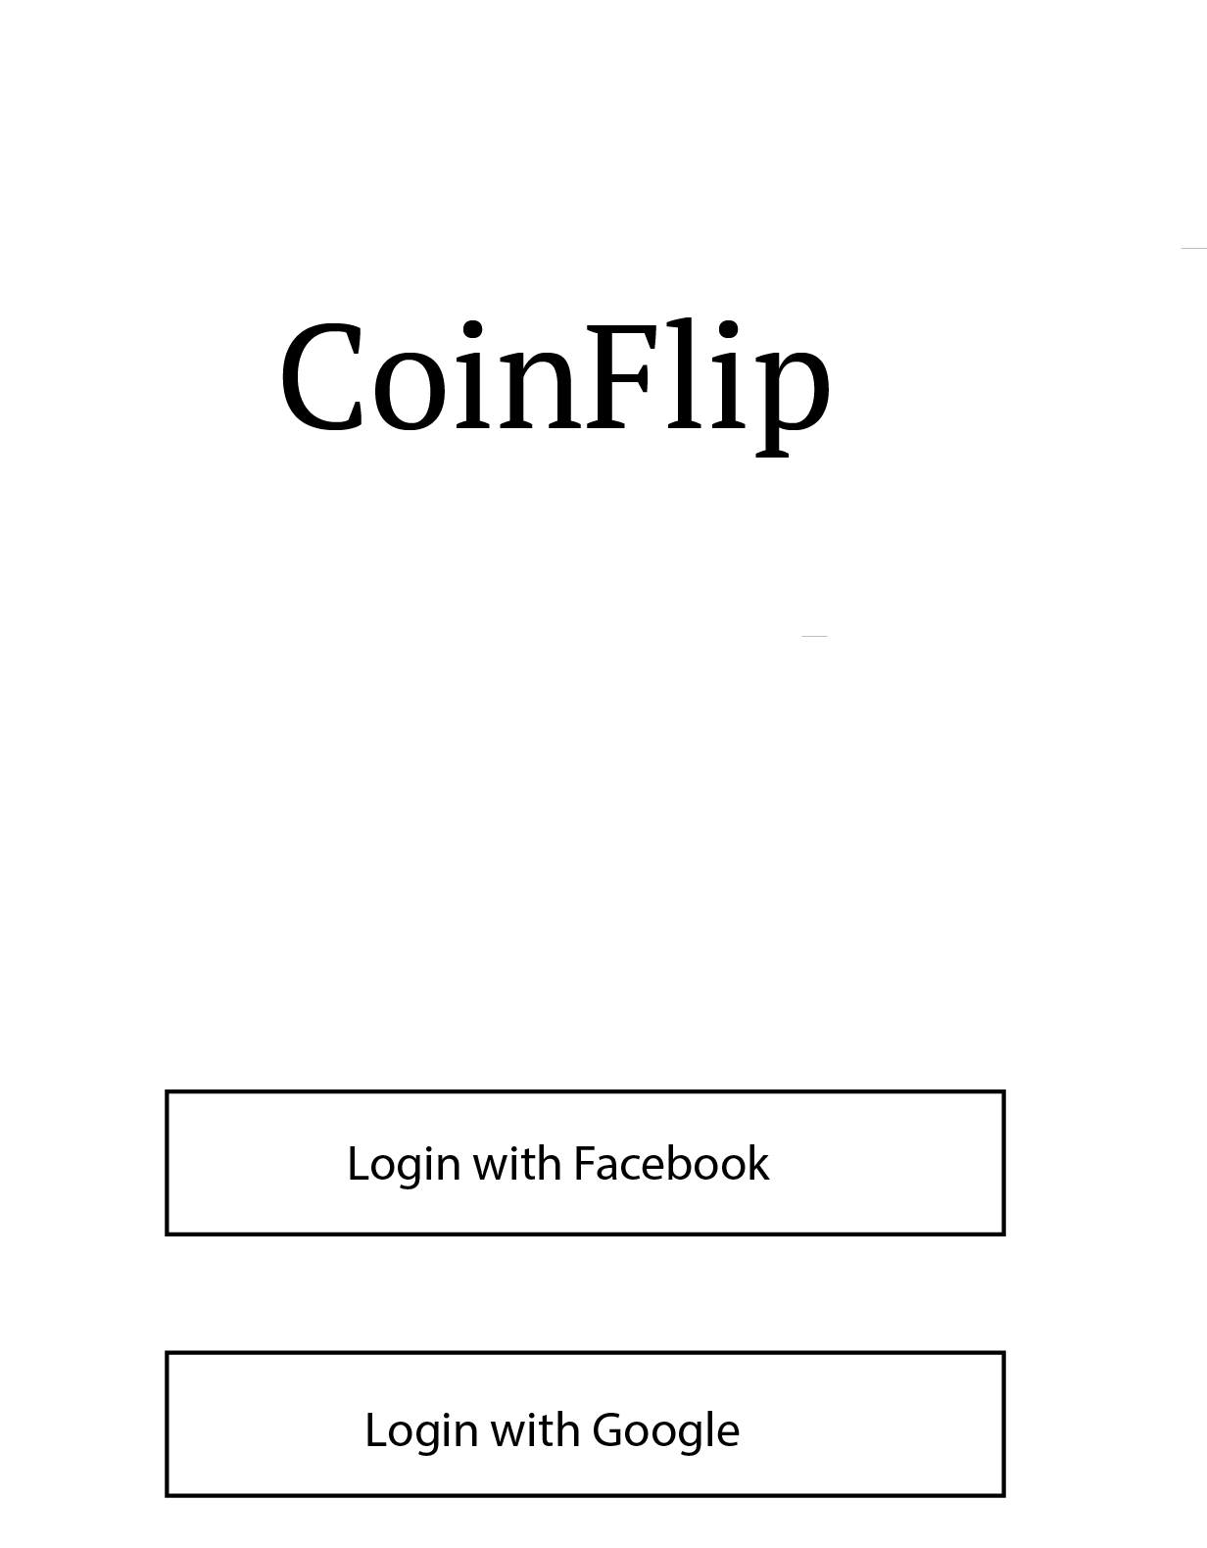
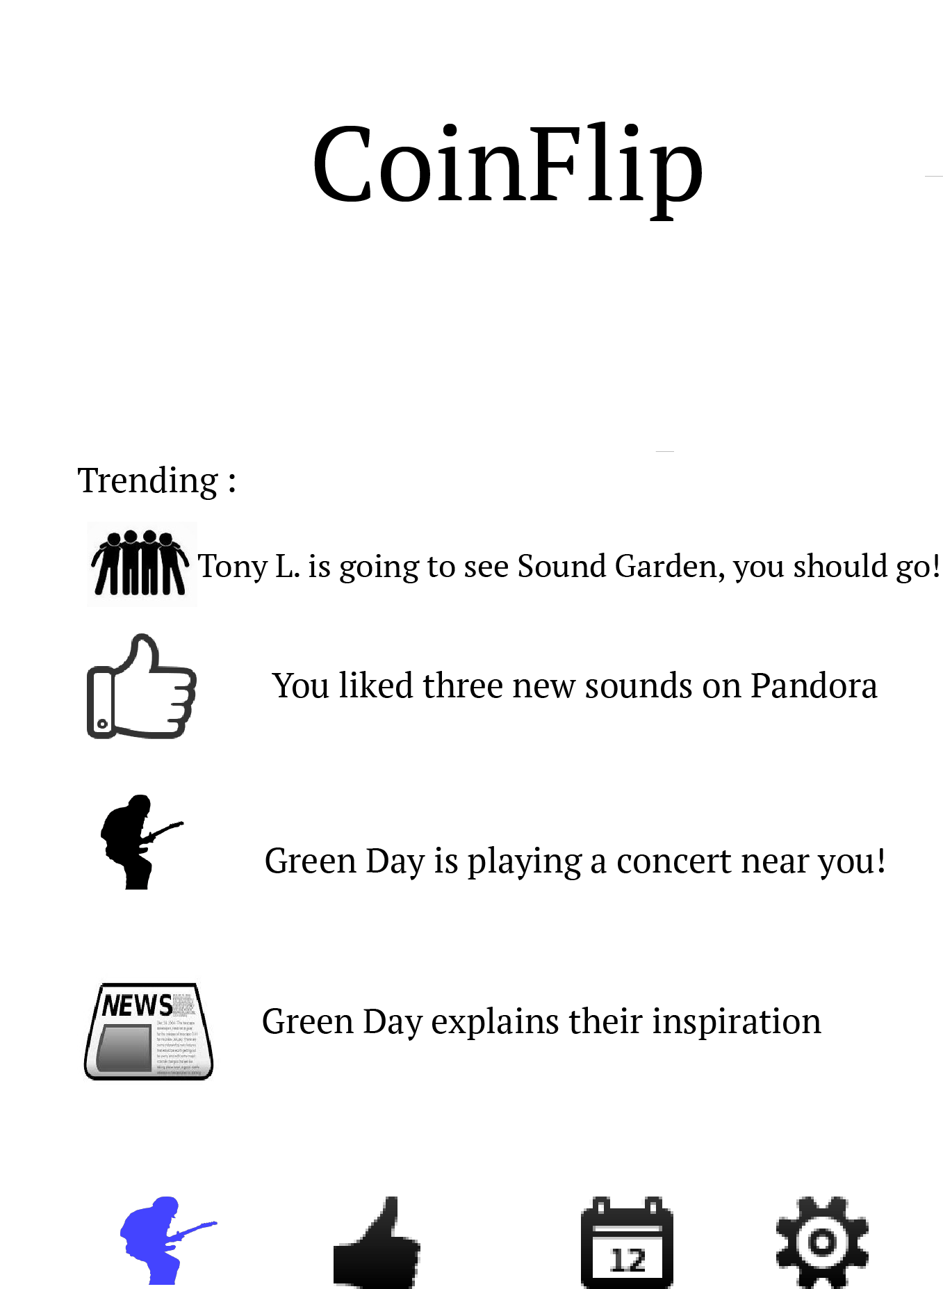
Wire Frames

Slide 17
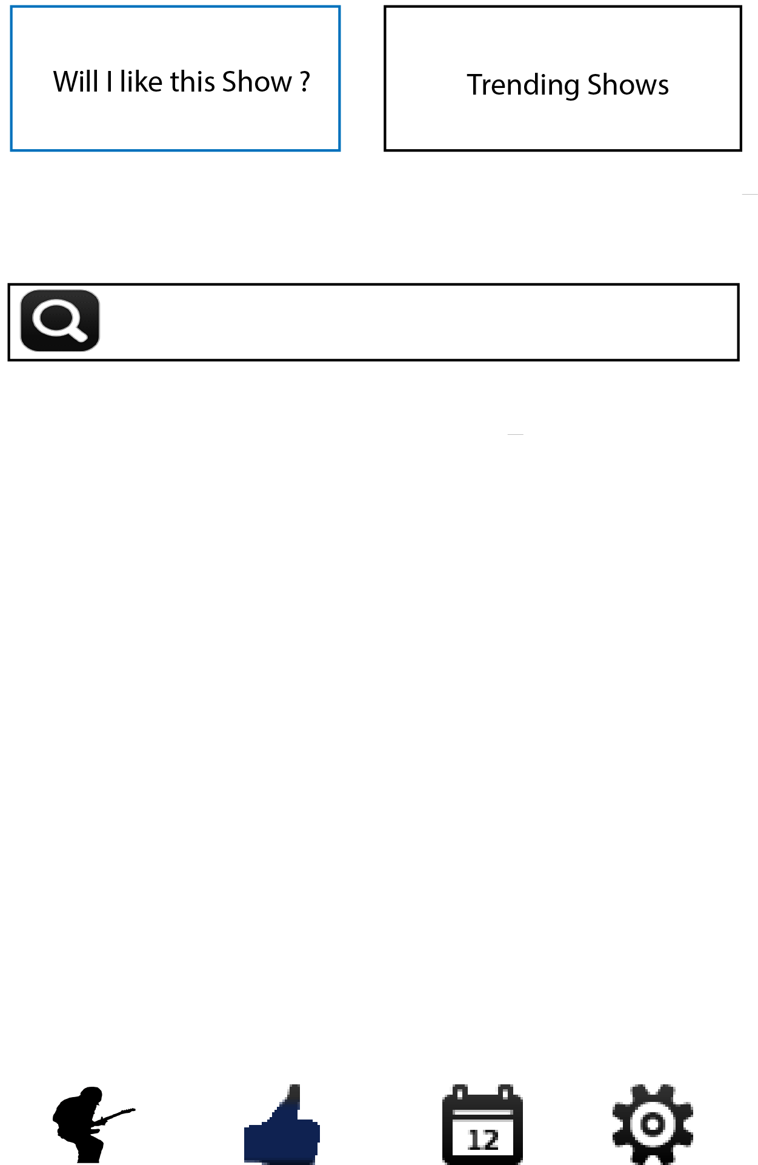
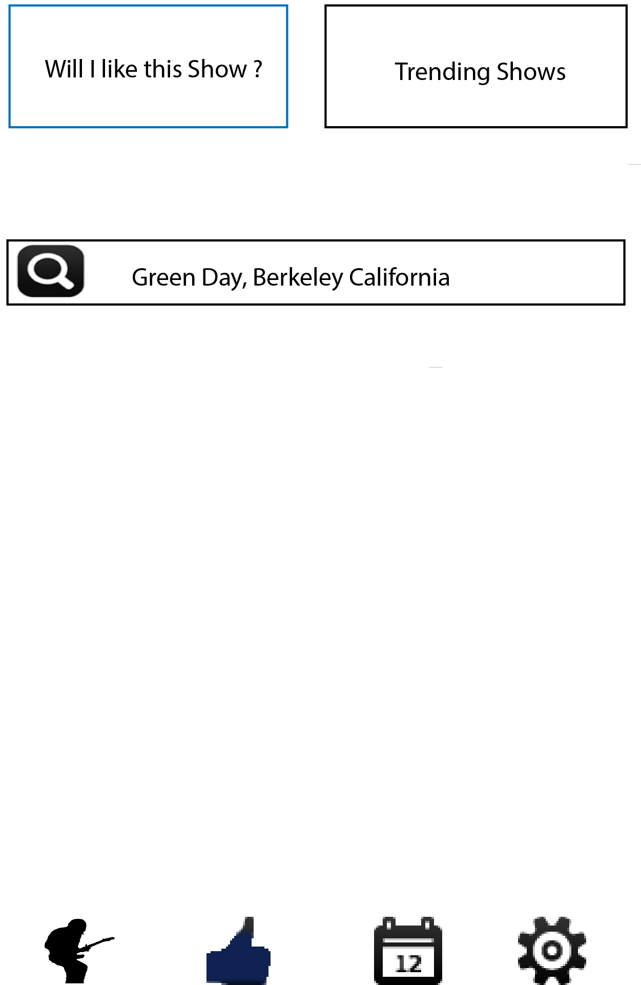
Wire Frames

Slide 18
Wire Frames

Slide 19
Q2 2014
Q3 2014
Q4 2014
Q1 2015
Q2 - 2015

Slide 20
Business Model: AAGGG
Activation | Uses the Passive Recommendation Engine to see if they will like any live show around them based on their user preferences | 25.0%
Retention | Uses the Active Recommendation Engine to see if they will like a specific live show more than once a month | 10.0%
Retention | Uses the Passive Recommendation Engine to see if they will like any live show around them based on their user preferences more than once a month | 20.0%
Retention | Bi-Weekly Email Notifications of trending shows in the users area | 10.0%
Retention | Push Notifications to alert users of upcoming shows of their favorite bands | 15.0%
Retention | Push Notifications to alert users of news articles and concert reviews of their favorite bands | 20.0%
Retention | Possitive Press Reviews | 1.9%
Referral | In App Referrals: add functionality to invite other users to use the application | 0.9%
Referral | In App Social Media: add functionality to promote activity on the app to social media to build brand awareness | 1.1%
Referral | Positive Application Reviews | 0.5%
Revenue | Break Even : Percentage of user from the market share to brake even | 0.2%
Revenue | Profit: : Percentage of user from the market share to make a profit | 0.4%

Slide 21
Road Map
Feature | Benefit to Product | Complexity | Risk | Priority | Version | Start Date | End Date | Duration
Market Research | Preform market research to gain insight into live music market | 3 | 5 | 1 | Vo | 5/1/14 | 5/7/14 | 6
Define Product Hypothesis | Define what needs there are to people who go to live music | 3 | 5 | 1 | Vo | 5/15/14 | 5/17/14 | 2
MVP | This will expose risk and find if there is a product market for an active predictive engine | 2 | 1 | 1 | Vo | 5/18/14 | 5/31/14 | 13
Mobile Application | Platform on which users will interface with CoinFlip | 4 | 3 | 2 | V1 | 6/1/14 | 8/18/14 | 78
Server | Provide Data for the application to interact with | 3 | 3 | 2 | V1 | 6/1/14 | 8/1/14 | 61
Reporting Dev. | Historical reports can be generated automatically without human input | 3 | 3 | 2 | V1 | 8/1/14 | 8/5/14 | 4
Recommendation Engine | Will provide the core feature of the application: to tell users if they are going to like a live concert or not | 1 | 1 | 1 | V1 | 6/1/14 | 12/31/14 | 213
Pre-Launch Marketing | Rise the awareness of the CoinFlip application prior to launch | 2 | 2 | 2 | V1 | 10/1/14 | 12/31/14 | 91
Reporting Publish Reports | These reports will be sold to interested parties | 3 | 3 | 2 | V1 | 1/3/15 | 1/4/15 | 1
Application Launch | Make the application for download on the Mobile store fronts | 5 | 5 | 1 | V1 | 1/3/15 | 1/4/15 | 1
Post- Launch Marketing: Growth | Drive users to download page on the mobile store fronts | 2 | 2 | 1 | V1 | 1/3/15 | 3/1/15 | 57
Application Dev: Refinement and market Growth | Feature refinement to ensure users get the most out of the application | 2 | 2 | 1 | V2 | 1/4/15 | 2/28/15 | 55
Launch v2 of the Application | Push updates to the application aimed at growth | 4 | 4 | 1 | V2 | 3/1/15 | 3/2/15 | 1
Feature Retention and market Growth | Grow Market Share | 2 | 2 | 1 | V2 | 3/1/15 | 7/31/15 | 152
Revenue Growth | Grow Revenue | 2 | 2 | 1 | V3 | 4/20/15 | 12/31/15 | 255

Slide 22
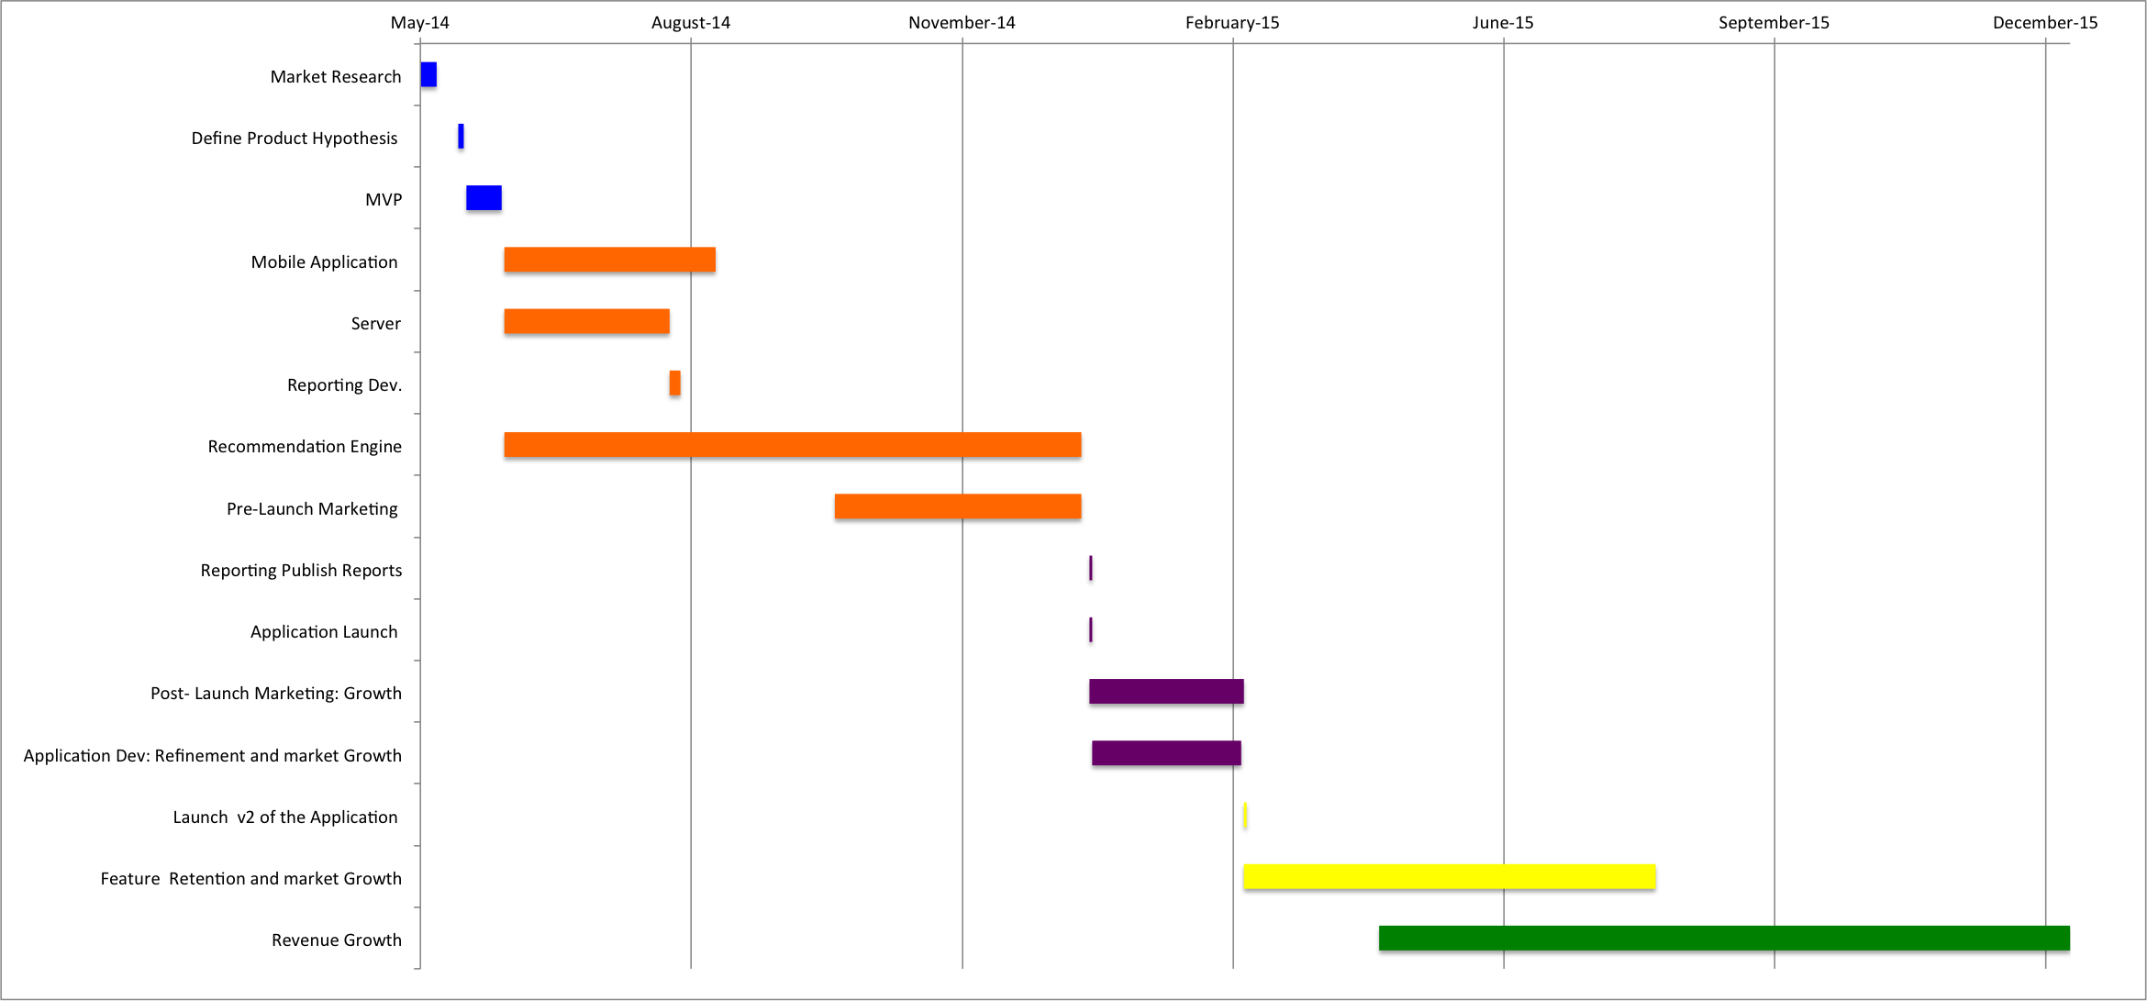
Road Map Graph

